Slide 1
Churn Modeling
Doug Kelly
GalvanizeU 6006: Churn Technical Presentation
03/08/2016

Slide 2
Presentation Outline
Data Collection & Processing
Exploratory Data Analysis
Feature Selection Using Lasso and Logistic Regression + Random Forest
Modeling & Validation
Churn Measurements
Losses, Expected Losses, high probability churn candidates

Slide 3
1. Data Collection & Processing
Binarize features
Scikit-learn Label Encoder for state feature
Dropped area code and phone number (later state)
Re-scaled numerical features
Split data:
Exploratory Set
Modeling sets X (independent variables), y (churn; dependent variable)
Customers

Slide 4
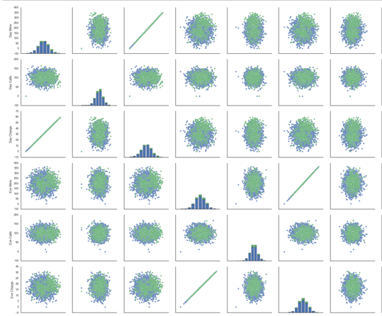
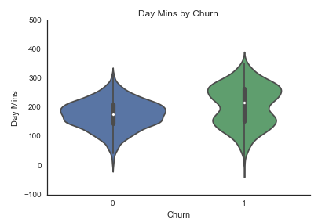
2. Exploratory Data Analysis
17 Features, 2 Binary
Perfect linearity between call and charge features
Several customer activity features have bimodal distributions
No outliers detected

Slide 5
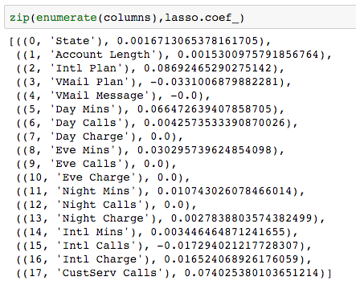
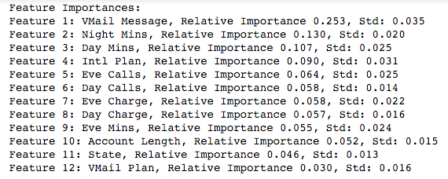
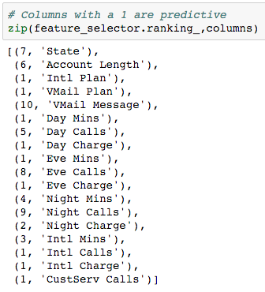
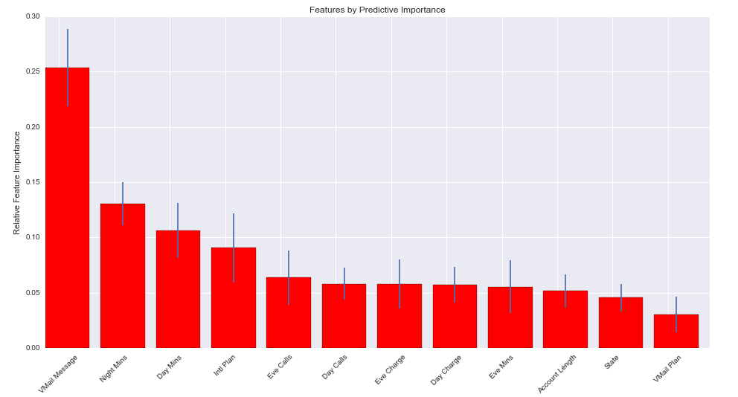
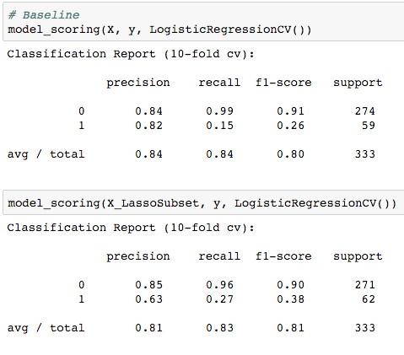
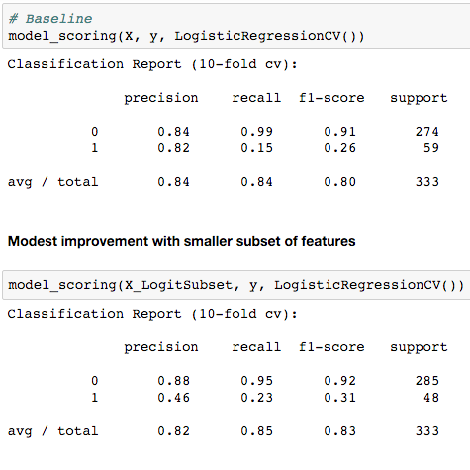
3. Feature Selection
Lasso (L1 norm)
Random Forest
Recursive Feature Selection

Slide 6
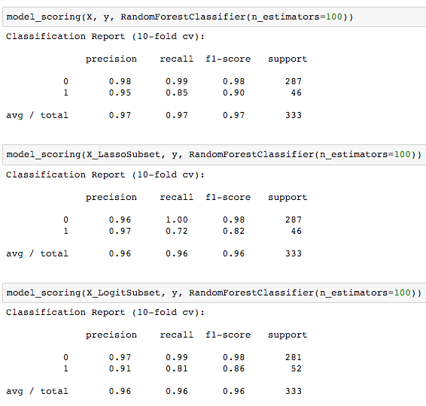
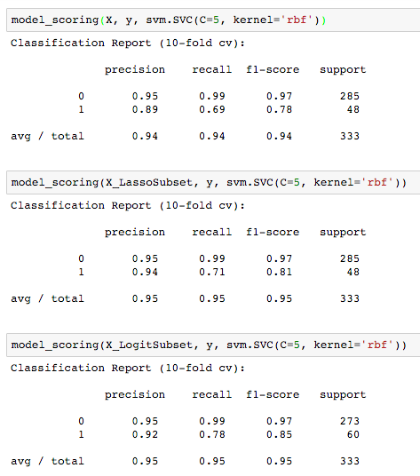
4. Modeling
Exhaustive Grid Search (Iterations weighted toward F1, Recall, Precision)
Random Forest
Support Vector Machines (SVM)

Slide 7
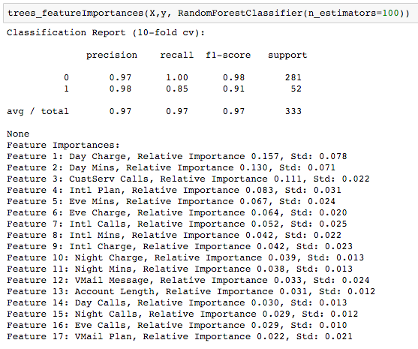
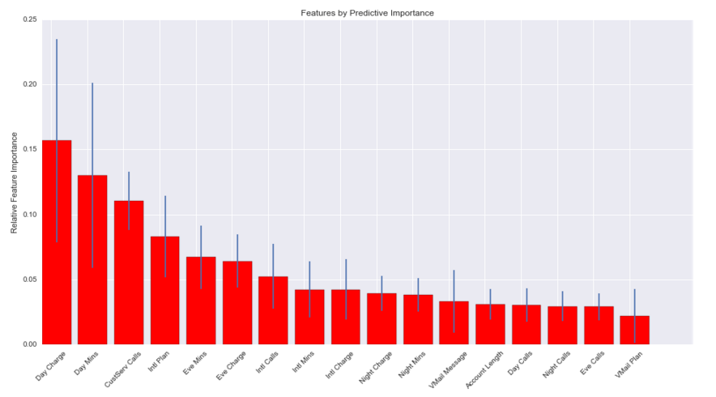
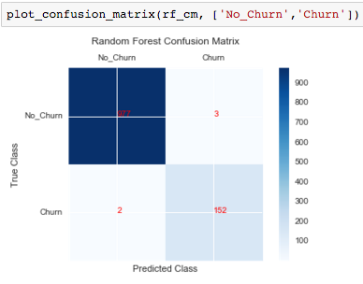
Winner: Random Forest

Slide 8
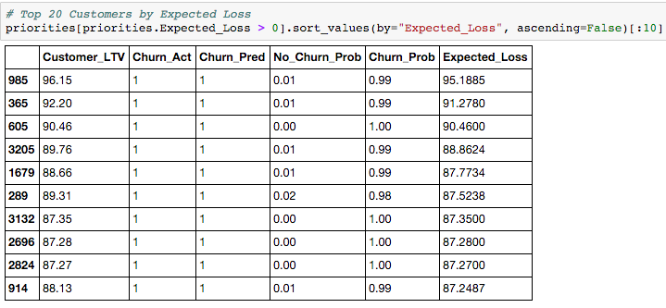
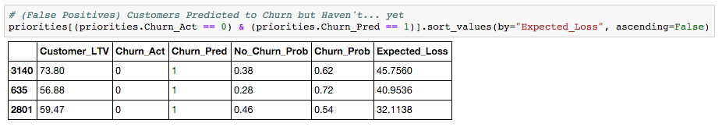
5. Churn Measurements
483 Customers churned with cumulative charges of $31,566.93
There are 3 high probability churn customers, worth $190.15, that have not churned yet. These customers can be targeted through customer contact, promotions, and marketing to dissuade them from churning and to avoid expected losses of $118.82

